Slide 1
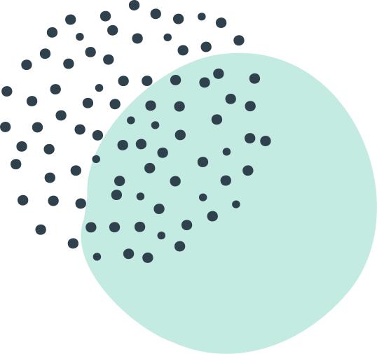
DSO 562
Fraud Analytics
Spring 2020
USC Marshall
Credit Card Transaction Fraud Analysis
Presentation by Group 23:
Aixuan (Ocean) Liu, Chao Wang, Cheng (Ivy) Shi,
Chengjun Liu, Minglu Chi, Shijie (Selene) Xiang

Slide 2
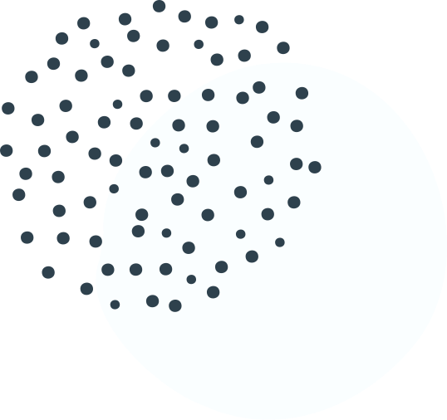
Agenda
Executive Summary
Data Quality Report & Data Cleaning
Variable Creation
Feature Selection
Modeling
Results
Conclusion

Slide 3
Part 1 -
Executive
Summary

Slide 4
Business Problem:
Detect fraud credit card transaction
in real-time
Data
Our Goal
Our Result
Credit card transaction of a Tennessee government agency in 2010
Build a supervised machine learning model to identify fraud in real-time
A model based on the Neural Network algorithm, 54.7% fraud detection rate (FDR) at 3% on validation data

Slide 5
Part 2 -
Data Quality &
Data Cleaning

Slide 6
Shape
Recordnum,
Cardnum,
Date,
Merchnum*,
Merch description,
Merch state*,
Merch zip*,
Transtype,
Amount,
Fraud
10 fields, 96,753 records
Fields
9 categorical, 1 numeric
Data Quality
Problems
Single outlier
Missing Value*

Slide 7

Characteristics of
Credit Card Transaction Fraud
Happen usually because credit card got stolen, counterfeited, hacked, etc.
Have common point of compromise: used by fraudsters, sometimes bad merchants, to make fraud transactions
Happen in previously unseen location/merchants for a card
Usually happen in a burst in an attempt to game detection mechanism
Notes:
Burst of activity at different merchants
Larger than normal purchase amounts, same or different merchants
Used at merchants not used before for that card
Used at a very different geography
Used at a high risk merchant (online, jewelry, electronics…)
Increased usage in card-not-present
Employee or merchant invents transactions
Infrequent recurring charges, same amount or same merchant
Employee or merchant invents a fictitious merchant

Slide 8
Merchnum
Matching by Merch description
Filling remaining records with Recordnum
Merch state
Matching by Merch description
Matching by Merchnum
Match by Merch zip (using library uszipcode)
Filling remaining records with Recordnum
Data Cleaning
Merch zip
Matching by Merch description
Filling remaining records with Recordnum

Slide 9
Part 3 -
Variable
Creation

Slide 10
Motivation
Build as many expert variables as possible to catch patterns of fraud transactions
Signals of card transaction fraud
Amount
Unusually high transaction amount
Transaction frequency
Infrequent recurring charges
Burst of fraud activities
Geography of transaction
Transaction happens at merchants not seen before
Merchant
Transaction is made up by the merchant

Slide 11
Combine related fields
Create candidate variables
Cardnum
Merchnum
Cardnum - Merchnum
Process
Cardnum - Zip
Cardnum - State
Look back in time to calculate values for each record
Amount variables
Days-since variables
Frequency variables
To identify unusual purchase amount
240
Average, maximum, median, total,
Actual/average, actual/maximum,
actual/median, actual/total
Cardnum, merchnum,
Cardnum – merchnum,
Cardnum – zip, Cardnum - state
Amount by/at this
Over the past
0, 1, 3, 7, 14, 30 days
To identify transaction frequency
5
Current date minus date of most recent transaction with the same
Cardnum, merchnum,
Cardnum – merchnum,
Cardnum – zip, Cardnum - state
To identify transaction frequency
30
Cardnum, merchnum,
Cardnum – merchnum,
Cardnum – zip, Cardnum - state
Number of transactions with the same
Over the past
0, 1, 3, 7, 14, 30 days

Slide 12
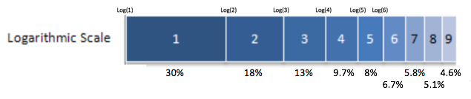
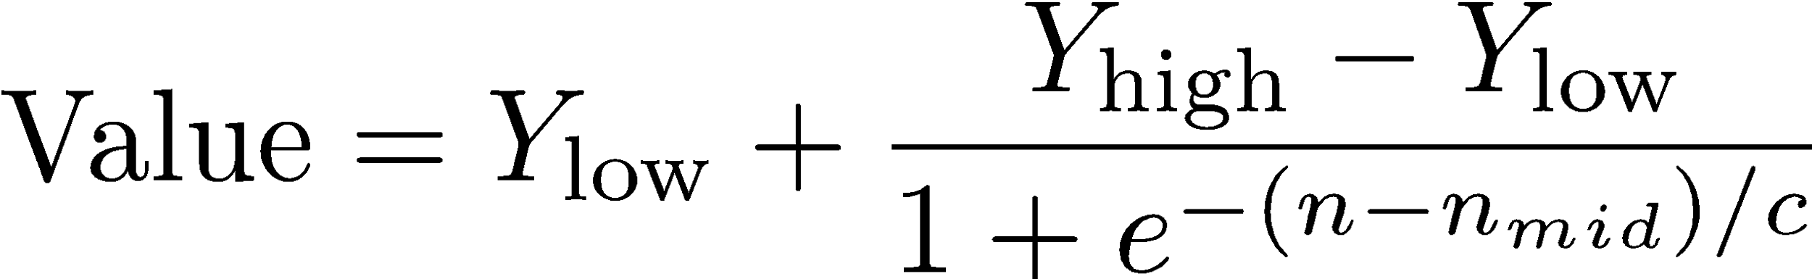
Create candidate variables (continued)
Process
24
Velocity change variables
Benford’s law variables
Risk table variables
To identify transaction frequency
Look back in time to calculate values for each record
Total number
Total amount
Cardnum
Merchnum
0, 1 day
of transactions with the same
Over the past
Daily average number
Daily average amount
Cardnum
Merchnum
of transactions with the same
Over the past
7, 14, 30 day
2
To identify fictitious transaction
Smoothed U* for
Cardnum, merchnum
To identify relationship between day of week and fraud
1
Day-of-week risk table variables
(c = 3 and nmid = 15)

Slide 13
Part 4 -
Feature
Selection

Slide 14

Preparation
Remove first 2 weeks of records
Day Since variables have limited days to look back into
Z-scale
To make sure all variables in the same scale
Add two variables “random” & “fraud”
Check if the KS and FDR filters work efficiently
Notes:
With around 300 variables created, we conduct feature selection with a two-step method. We first use univariate filters to select the most promising 80 variables, and then use a forward selection wrapper to reduce the dimensionality and keep the best number of variables.
Before conducting feature selection, we did several steps to prepare the data properly.
To test whether our filters work efficiently, we add random and fraud into our variables.

Slide 15
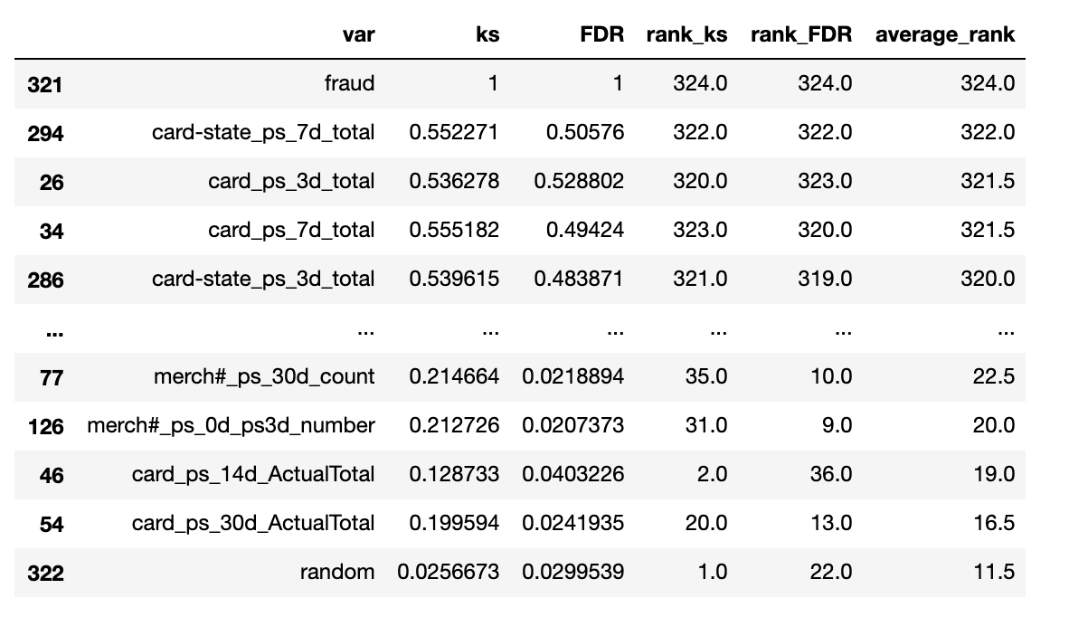

Univariate Filters
“Kolmogorov-Smirnov” (KS) score
To measure how well a particular variable can distinguish the distribution of the normal records and the fraud records
Fraud Detection Rate (FDR) at 3%
To measure the proportion of true positive among the records with the top 3% highest/lowest value
Drop “Fraud” and select top 80 variables by “average_rank”
Notes:
We use two measures of goodness as filters: “Kolmogorov-Smirnov” (KS) score and Fraud Detection Rate (FDR).
The KS score is used to measure how separate is one distribution from the other distribution. By calculating KS, we can measure how well a particular variable can distinguish the distribution of the normal records and the fraud records. The higher the KS score, the better performance of the variable in separating fraudulent records from normal records.
The FDR is the percentage of correctly detected frauds among records at a certain percentile. We leverage FDR score to measure a variable’s ability to find true positive among the records with the top 3% highest/lowest value. The higher the FDR score, the better performance of the variable.
On the right side, you can see the result of our filters, sorted by average rank.
Fraud ranks at the top while the random ranks at the bottom, which suggests that
Drop

Slide 16
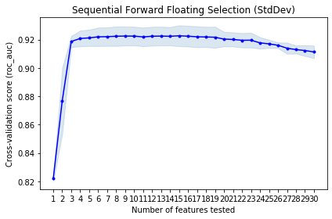
80 to 25
Five Runs
Wrapper
Best score
0.916959
Optimal number of features
25
Based on the recommendation of the wrapper, we pick the top 25 variables
Sequential Forward Selection (SFS)
Model: Logistic Regression
Notes:
It used forward selection technique to select a subset of features that is most relevant to the problem. estimator
Drop our features from 80 to 25 stepwise with five runs. You can see the graph plotted from the final run here. The optimal number of features suggested by the algorithm is 25 with best performance score of around 0.91.
Therefore, we moved forward with 25 features to do modeling. Next, selene will talk about the details of our modeling process.
Other notes: Sequential feature selection algorithms are a family of greedy search algorithms that are used to reduce an initial d-dimensional feature space to a k-dimensional feature subspace where k < d. The motivation behind feature selection algorithms is to automatically select a subset of features that is most relevant to the problem. The goal of feature selection is two-fold: We want to improve the computational efficiency and reduce the generalization error of the model by removing irrelevant features or noise. A wrapper approach such as sequential feature selection is especially useful if embedded feature selection -- for example, a regularization penalty like LASSO -- is not applicable.

Slide 17
Part 5 -
Modeling
Notes:
Okay. After we selected the most important features, we start to find the best model for our card transaction classification.

Slide 18
LOGISTIC REGRESSION
NEURAL NET
Train: 0.64
Test: 0.63
Train: 0.78
Test: 0.74
Types of
Models
RANDOM FOREST
BOOSTED TREE
Train: 0.84
Test: 0.66
Train: 0.87
Test: 0.67
Notes:
In total we used four kinds of classification models to find the most effective model by comparing FDR 3% score. In addition, to remove the influence of randomness, we applied 10-Fold Cross Validation to make sure the scores are comparable. Here are the performance of four models with their best parameters, and we found Neural Net worked the best with good testing scores and small difference from Training scores.

Slide 19
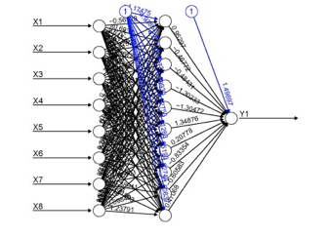
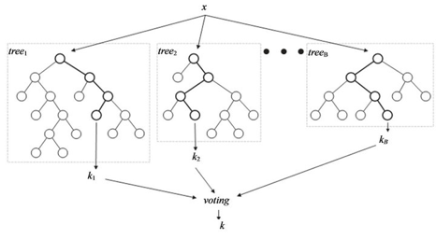
Input Layer
Hidden Layer
Output Layer
NEURAL NET
The
Models
Input layer, hidden layer, output layer
Nodes in hidden layer receives weighted signals from previous layer and does a transformation
The weights of signals are what need to be trained
Each record pushed through the algorithm one by one, all the weights will be gradually adjusted
RANDOM FOREST
Each tree is a full model to predict the output and is a strong learner
Voting and averaging are two common ways to combine all the strong trees
BOOSTED TREE
A linear combination of weak learners to result in a strong learner
Each weak learner is trained to predict the residual error of the current sum
Notes:
Among those models, I’d like to elaborate a bit further about Neural Net, Random Forest, and Boosted Tree. In neural net, we input the features into a system of neurons and the neurons aggregate and transform the features to make predictions. As more samples are studied, the connections between neurons will learn to adjust, so that we have more and more accurate predictions. In random forest, we randomly generate subsets of samples and train a number of trees for prediction. By voting or averaging, we can make sure the final models can be applied to all samples without overfitting. In boosted tree, we build a tree and get residuals, and we build the next tree with residuals, and the next tree with the next residuals. Combining the trees we can get the final model that is able to predict almost all details.

Slide 20
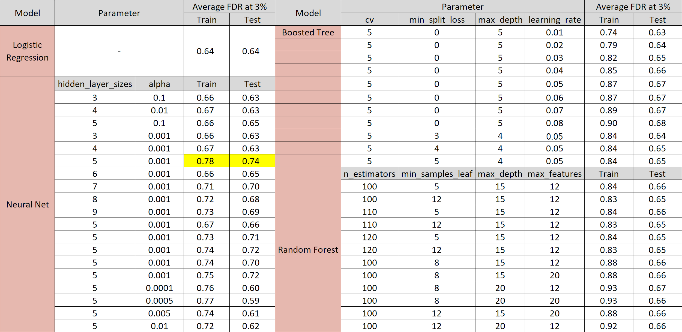
Select favorite algorithm and hyperparameters
Notes:
In addition to models, we have to find the best parameters to reach maximum accuracy. We use two methods to go through the models and hyperparameters: Grid Search to go over more than 30 parameter combinations and 10-Fold Cross Validation to remove the influence of randomness and make sure the scores are comparable. We notice that the parameters marked by yellow is the best, with high training score of 0.78 and low difference of 0.04 between training and testing datasets. So we believe Neural Net with one layer of 6 cells and alpha of 0.001 is the best choice for the next step of validating the model. This comes to our next part of validation results. To validate our final model, first we split the training-testing dataset into 80% and 20% to train the neural net, sort the fraud possibility of records and build model performance tables of training and testing dataset. Then we use the whole training-testing dataset to train the model to validate out-of-time possibilities and build model performance table. We can see from the tables that for training dataset the FDR 3% score is 78.5%, the testing dataset 74.7% and 54.7% for out of time records. We are convinced by three tables that almost all fraud records are marked with top 20% probabilities, which proves the efficiency of our final Neural Net model. I will hand it to Ocean for more suggestions on how to apply this model and details of examples.

Slide 21
Part 6 -
Results
Notes:
Here is the performance of the training, testing dataset, and the OOT performance of the final model.
We split each data set into 100 bins and the tables below show the FDR among the highest-ranking 20% in terms of fraud possibility with bin statistics and the cumulative statistics.

Slide 22
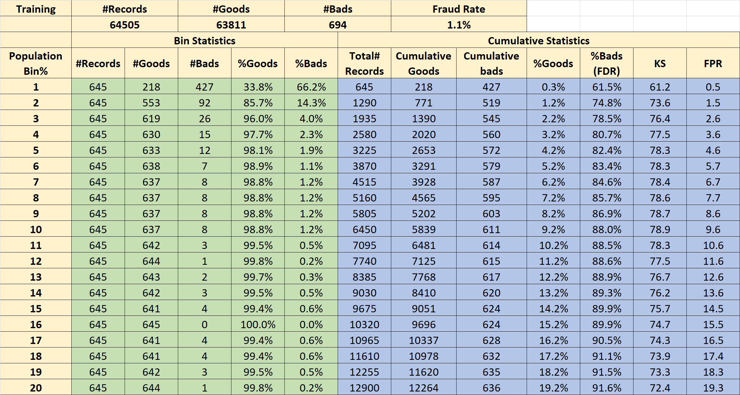
Performance on Training Dataset

Slide 23

Performance on Testing Dataset

Slide 24
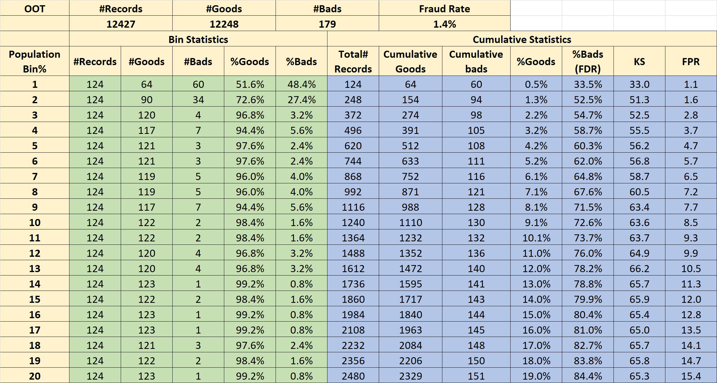
Performance on OOT Dataset

Slide 25
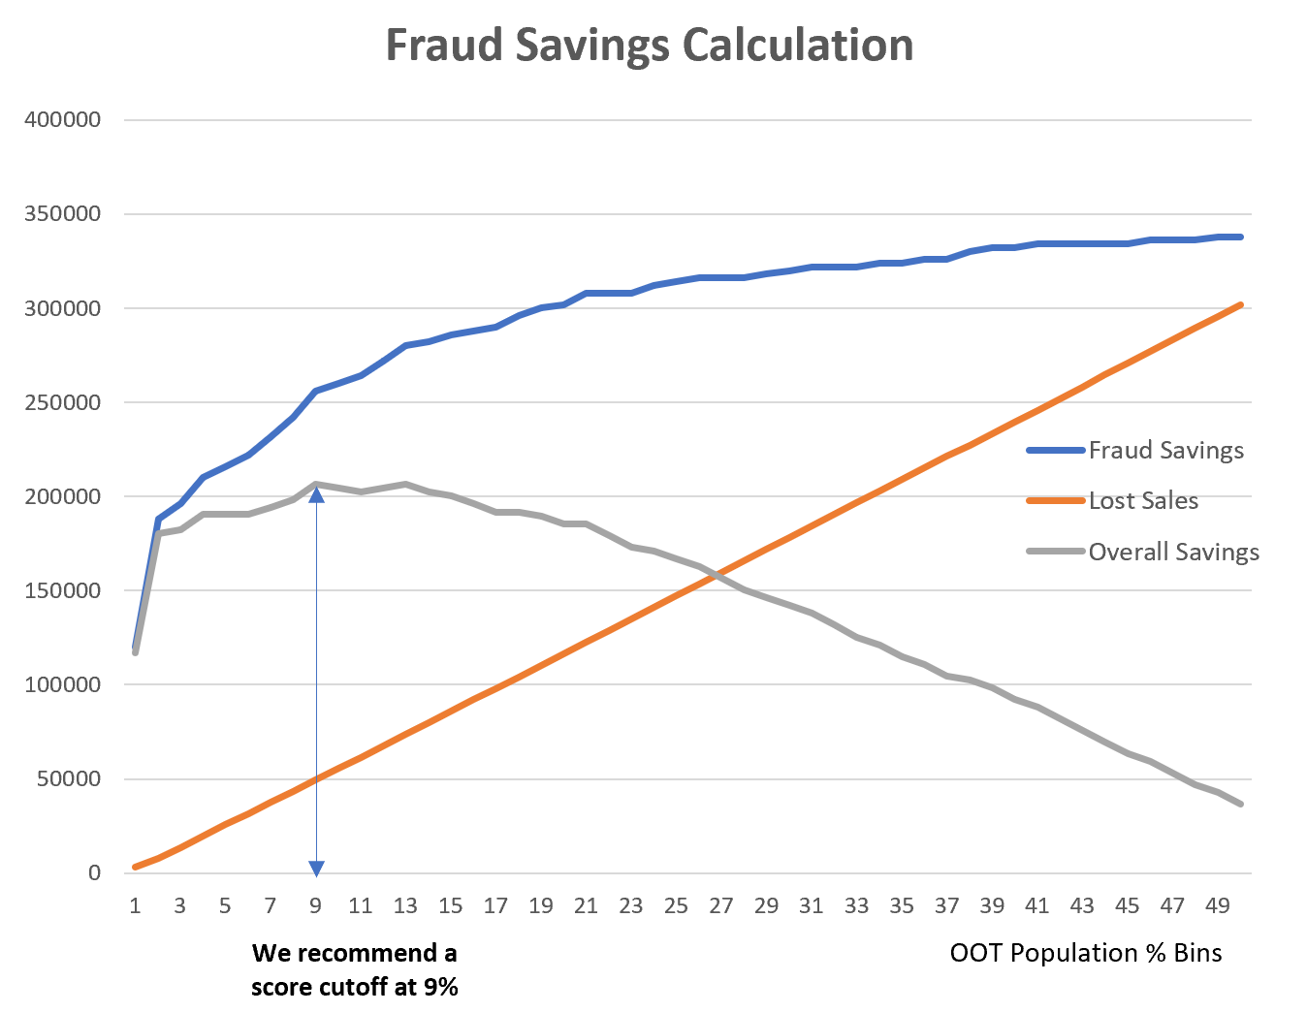
Suggest Score Cutoff at 9%
Notes:
Thanks Chengjun.
Based on the results of the OOT dataset. we select the score cutoff point through fraud savings calculation.
We Assume 2000 dollar gain for each fraud that’s caught, the blue curve shows the accumulated gain from fraud savings
On the other hand, we Assume 50 dollar loss for every good record that’s flagged as a bad. The red curve here shows the accumulated loss.
Then, we calculate the overall savings as fraud savings minus lost sales
We select the highest overall savings point as the score cutoff point, so we suggest cutoff at 9%. which means, After we score each record and rank the orders, we suggest to define the top 9% records as fraud in the model.

Slide 26
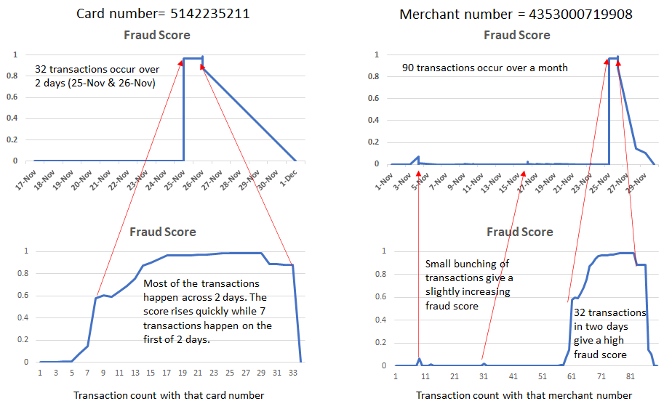
Examples: Fraud Scores Increase With Activity
Notes:
Also, From the result, we can see the pattern that Fraud scores rise as they see more activity at the entity level like card # and merchant #.
Because the model need to go through the process to understand the fraud activities. When the transaction of the same entity occurs a certain times and cross the threshold, it will be detected to be suspicious.
Here is example:
the graph on the left side shows that, for this card number, the score rises quickly when many transcations happen accross two days.
And The graph on the right side is the example of a merchant. For this merchant number, there’s the similar pattern that many transaction in a short time period give a high fraud score. Also, small bunching of transactions give a slightly increasing fraud score.

Slide 27
Part 7 -
Conclusion
Notes:
Here comes to the conclusion part.
Overall, we analyze the business problem and define our goal to build supervised machine learning model to detect fraud from real time credit card transaction data.
First, we do a Data Quality Report to explore and understand the whole dataset. Then we do data cleaning and create variables based on our analysis of the credit card transaction fraud pattern.
Later, we do feature selection to reduce dimension. After trying different types of algorithm, we select neural net to build the final model. Then We look at the results and evaluate the performance, and give suggestions for cutoff point to get the highest overall savings.
This is all of our presentation

Slide 28




Our Approach
Data preparation, feature engineering, feature selection
Performance on validation data: FDR 3% of 54.7%
Analysis of business problem
Application of machine learning algorithm

Slide 29

Thank you for listening!
Presentation by Group 23:
Aixuan (Ocean) Liu, Chao Wang, Cheng (Ivy) Shi,
Chengjun Liu, Minglu Chi, Shijie (Selene) Xiang

